Slide 1
Singapore
Private Housing Market
Analysis
Eugene Chua
1048186J
IT8701
Introduction To Programming For Data Science
CA 2 Assignment

Slide 2
Introduction
The residential real estate market in Singapore has been an attractive investment asset to foreign buyers.
According to Statista, the Residential Real Estate market market in Singapore is estimated to reach a value of US$1.52tn by the end of 2024.
In the Jupyter notebook accompanying this slide deck, we seek to understand Singapore’s private housing market in 4 sections:
Private Residential Property Transactions Overview
Interest Rates & Private Property Sold
Private Property Price Index
Analyzing Singapore's 3 Main Regions

Slide 3
Libraries &
Datasets
Libraries
Pandas
Numpy
Matplotlib
Seaborn
Datasets & URLs
Private Residential Property Transactions in Singapore
https://beta.data.gov.sg/collections/1658/view
SORA Interest Rates
https://www.mas.gov.sg/monetary-policy/sora
Private Residential Property Price Index
https://beta.data.gov.sg/collections/1676/datasets/d_97f8a2e995022d311c6c68cfda6d034c/view
HDB Resale Price Index
https://beta.data.gov.sg/collections/152/view
Private Property Transactions
https://www.ura.gov.sg/property-market-information/pmiResidentialTransactionSearch

Slide 4
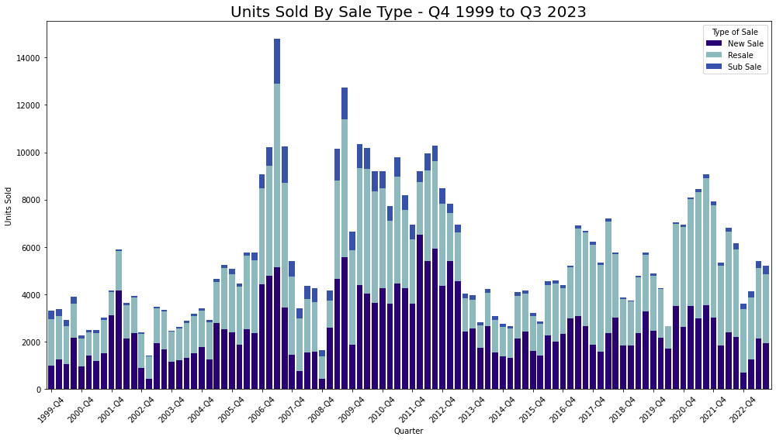
Dataset:
Private Residential Property Transactions in Singapore
Methodology:
I used pandas to load the dataset. Next, I checked for null values and the unique values in each column.
There are 3 types of sale in this dataset: `New Sale`, `Resale`, `Sub Sale`.
Using the `pivot_table` function, I grouped the data according to sale type and extract the number of units sold for each type.
Insights:
From Q4 1999 to Q3 2023, 530,164 private residential property units were sold in Singapore.
Despite cooling measures introduced by the government in 2013, the property market stabilized and has found its footing.
As the world recovers from the COVID pandemic, barring significant government intervention, the private property market is poised to return to pre-pandemic levels.
1.Private Property
Market Overview

Slide 5
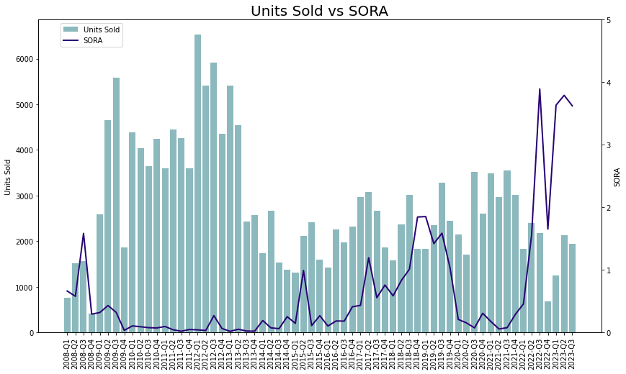
Dataset:
Private Residential Property Transactions in Singapore
SORA Interest Rates
Methodology:
I reused the same dataset from the previous section. For this section I filtered the data for ‘new sales’ only.
Next I loaded the dataframe for domestic interest rates and had to add a column for the quarter end date so that I could merge the 2 dataframes together using pd.merge.
After that, I plotted a bar chart showing the number of units sold and overlaid a line chart showing the SORA rates.
Insights:
From Q1 2008 to Q3 2023, the correlation between SORA rates and units sold was -0.33.
Despite cooling measures to prevent the market from overheating, it appears that Singapore private property has proven to be an attractive investment asset.
2. Interest Rates &
Private Property Sold

Slide 6
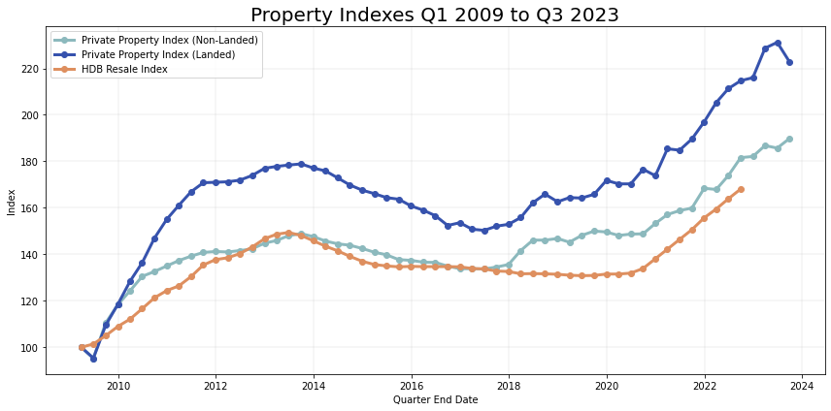
Dataset:
Private Residential Property Price Index]
HDB Resale Price Index
Methodology:
This section examines the private residential property index and compares it to the HDB resale index.
After using pandas to read the csv file, I added an additional column containing a date-time object for each quarters’ end.
Next I plotted a line chart comparing the performance of (i) landed private property, (ii) non-landed private property, and (iii) HDB resale flats.
Insights:
As of Q3 2022, the Private Property Index (Landed) was 222.9 while the the Private Property Index (Non-Landed) stood at 189.9. While no new data has been provided since Q3 2022, we can expect it to be in line with the strong uptrends exhibited by the private property indexes.
3. Private Property
Price Index

Slide 7
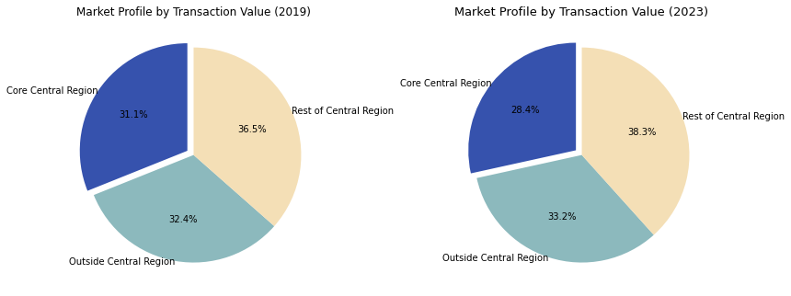
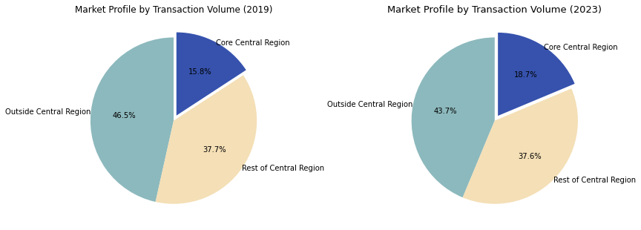
Dataset:
Private Property Transactions
Methodology:
I used pandas to load the CSV files and then concatenated them using pd.concat.
After checking for null values, I filtered them by year and market segment and plotted a pie chart to compare the market profiles of 2019 and 2023.
Insights:
The transacted value of apartments and condominiums grew from SGD25.8bn in 2019 to SGD35.0bn in 2023, representing a 36.0% increase during this period.
Nevertheless, the contribution from the 3 regions remaining stable with each contributing roughly a third. Furthermore, in 2023, none of regions' compositions deviated more than 2% from the their respective 2019 figures.
4. Analyzing Singapore’s
3 Main Regions

Slide 8
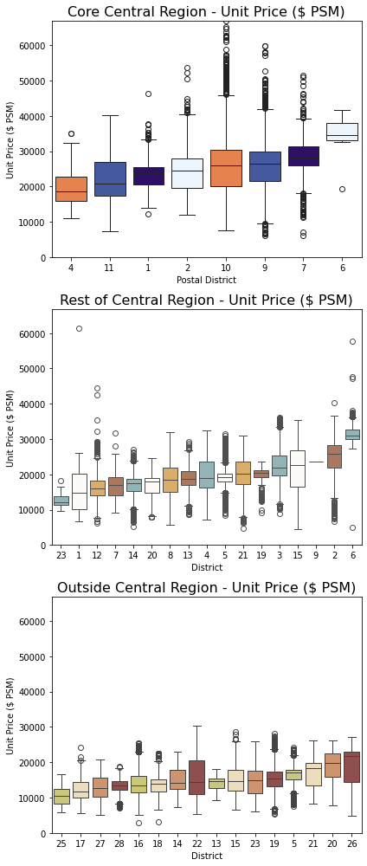
Dataset:
Private Property Transactions
Methodology:
Using the same dataset as the previous slide, I created dataset for each region. Using df.groupby, I grouped them by posteal district and unit price per square metre.
Next I sorted them by median prices. Finally, I charted them using a box plot.
Insights:
Given its premium location, the districts in the Core Central Region (CCR) registered considerably higher median prices compared to the other 2 regions.
Of all the districts, district 6 had the highest median price per square metre (PSM), registering a median of SGD34,654 for apartments and condominiums located in the CCR.
4. Analyzing Singapore’s
3 Main Regions

Slide 9
End Of Presentation

